Slide 1
True t₁ Classification and Estimation
Nov 16, 2022
Bobby Yang

Slide 2
Introduction
Modelling malignant tumors
Cancer is not homogeneous process
Different groups (clones) grow and mutate at different rates
Groups arrive at different times while cancer is formed
Interested in estimating arrival times
Estimate times by summary statistics
Robust to mutation rate, sample size, age of tumor
Single cell DNA sequencing data
Matrix: cells columns, mutation sites rows

Slide 3
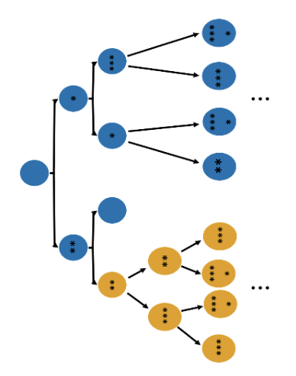
Introduction
Simulation: start with single cell
Divide, die, mutate with rates b_{i}, d_{i}, θ_{i}
At time t₁, one cell gains mutation that gives it an advantage, “clone 1”
Carry its “selective” mutations to its progeny
Repeats m times before tumor observed
End of time (t_{m+1}), sample cells, get summary statistics from single cell DNA sequencing
Simulated data: know true values of arrival times
Find patterns between summary statistics and true t₁

Slide 4
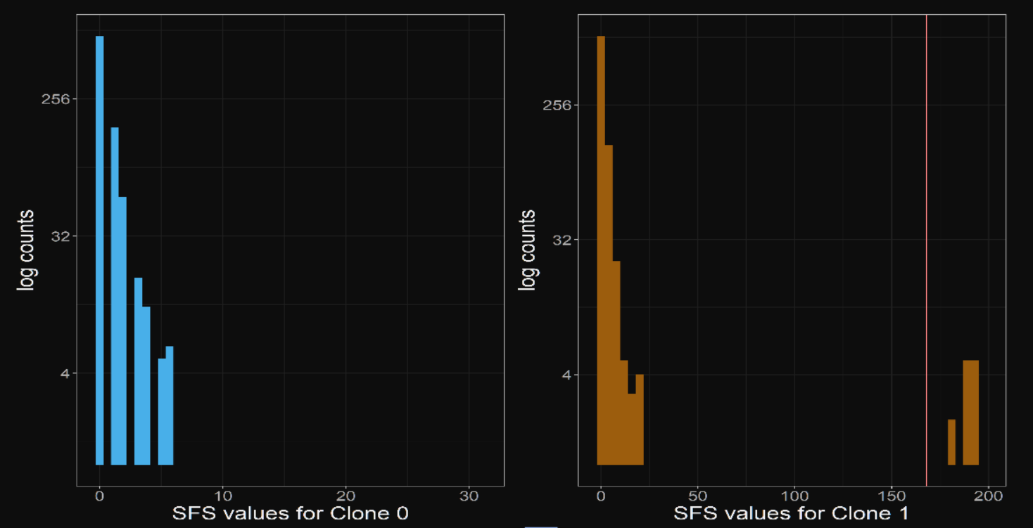
Introduction
Example: two clones
K₁ - mutations present in >α% cells of clone 1
A₁ - mutations present in <α% cells of clone 1
A₀ - all mutations in clone 0
No mutations shared among all cells in sequencing data
p₀/p₁ - proportion of cells in clone 0/1
t_{m+1} - age of tumor
n - sample size
θ - (estimated) mutation rate

Slide 5
Models
Use summary statistics to estimate arrival times of each tumor
Simulation - get true times
Classification - low/high t₁ groups (250-400, 700-900)
Logistic regression
Heuristic method (lines)
Regression - estimate actual t₁ values
Linear regression
Ridge regression
Comparison of model accuracy - all models cross-validated

Slide 6
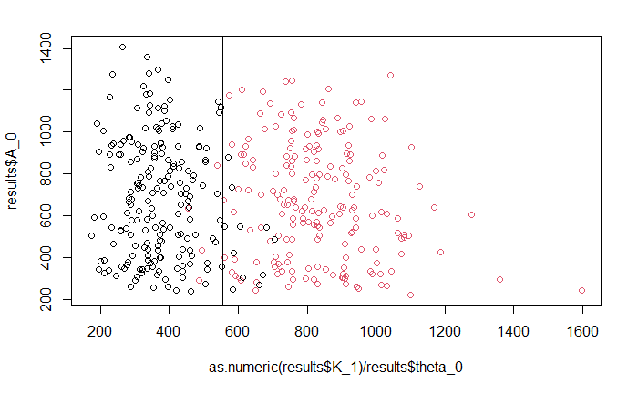
Truth data, varying theta
Line method CV accuracy: 0.95
Logistic CV accuracy: 0.955
Ridge K1,A1
RMSE: 97.4959
MAD: 81.7378
Linear K1,A1
RMSE: 96.6741
MAD: 44.5101
R^2: .9453
Linear K1 scaled, A1 scaled, p0
RMSE: 57.3570
MAD: 44.5101
R^2: .9433

Slide 7
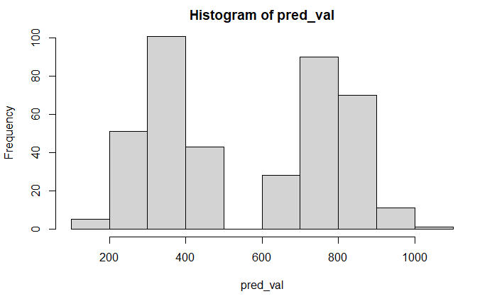
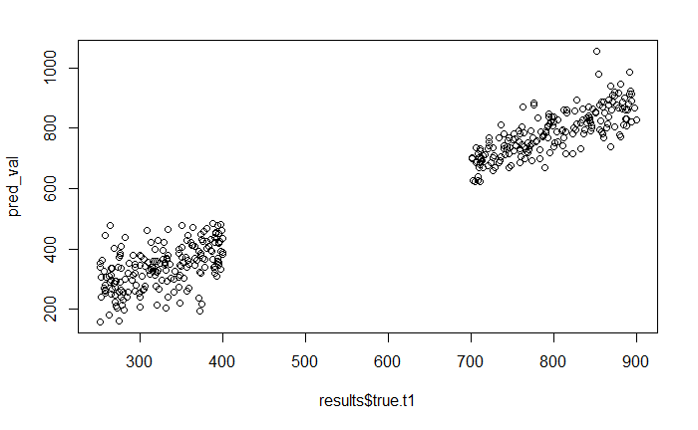

Slide 8
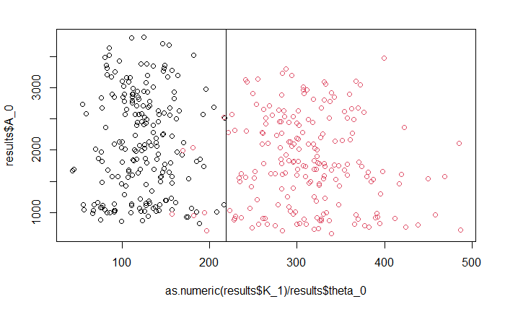
Single cell data, varying theta
Line method CV accuracy: 0.98
Logistic CV
K1 scaled: .975
K1,A1: .9925*
Ridge K1,A1
RMSE: 103.8625
MAD: 86.5023
Linear K1,A1
RMSE: 102.8441
MAD: 85.0759
R^2: .8223
Linear K1 scaled, A1 scaled, p0
RMSE: 44.8394
MAD: 36.8394
R^2: .9652
*not all parameters were p<.05

Slide 9
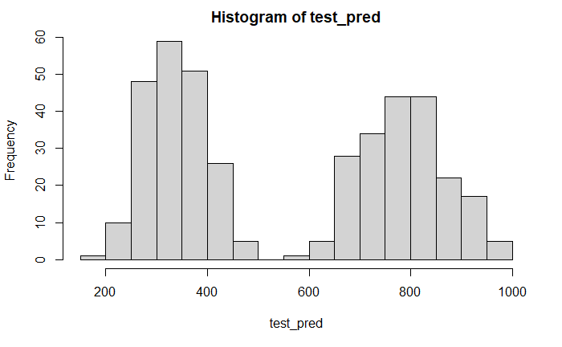
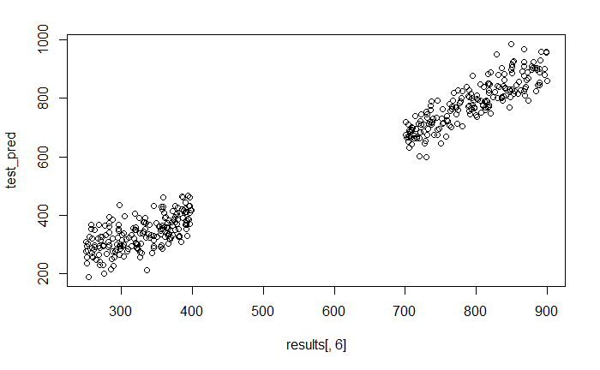

Slide 10
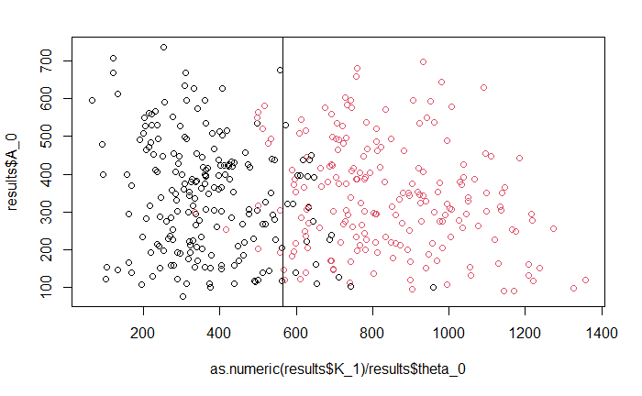
Truth data, varying n
Line method CV accuracy: 0.895
Logistic CV accuracy
K1 scale: .9175
K1,A1: .945
Ridge K1,A1
RMSE: 115.3186
MAD: 93.6900
Linear K1,A1
RMSE: 114.7128
MAD: 92.6741
R^2: .7784
Linear K1 scaled, A1 scaled, p0
RMSE: 118.128
MAD: 96.6619
R^2: .7589

Slide 11
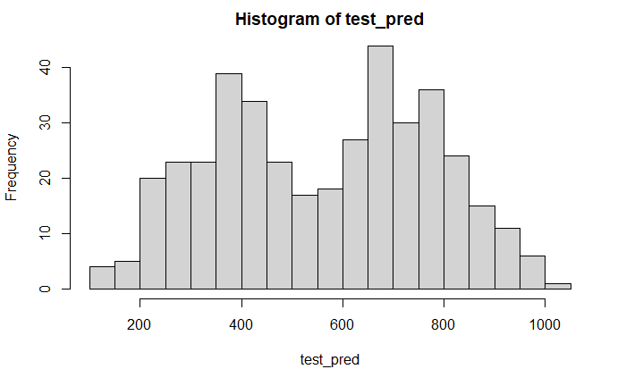
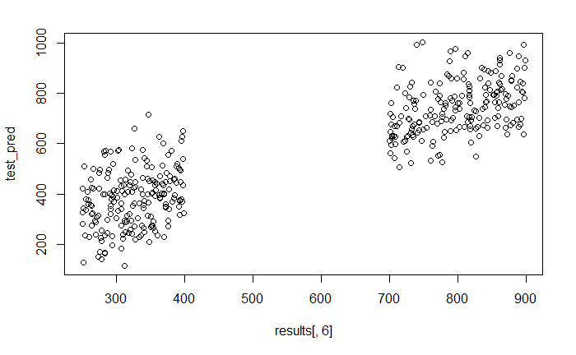

Slide 12
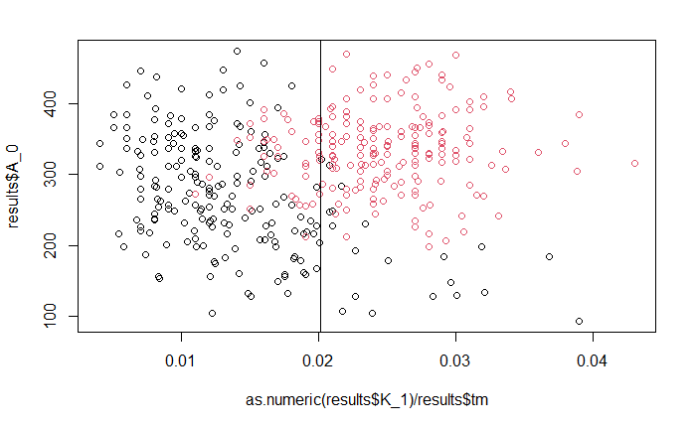
Truth data, varying tm+1
Line method CV accuracy: 0.85
Logistic CV accuracy
K1 scale: .8425
K1,A1: .9725
Ridge K1,A1
RMSE: 108.6712
MAD: 88.3641
Linear K1,A1
RMSE: 108.1109
MAD: 86.9628
R^2: .8152
Linear K1 scaled, A1 scaled, p0
RMSE: 113.8014
MAD: 85.8550
R^2: .7844

Slide 13
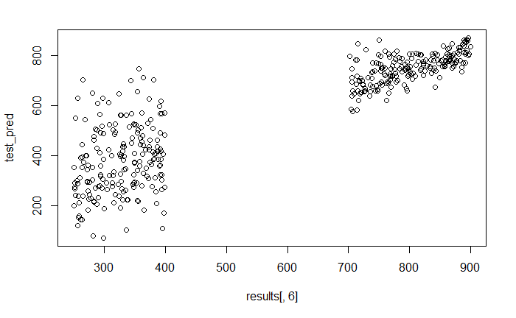
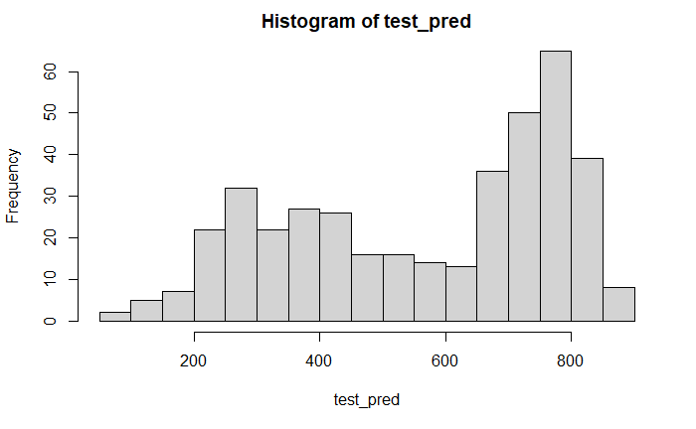

Slide 14
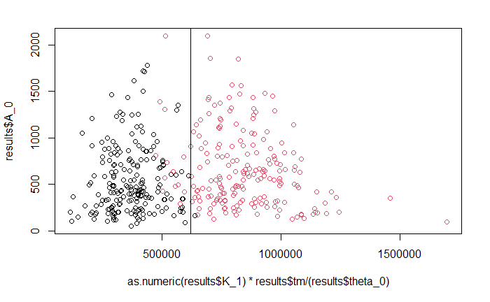
Truth data, varying all three
Line method CV accuracy: 0.965
Logistic CV accuracy
K1 scale: .875
K1,A1: .94
Ridge K1,A1
RMSE: 144.485
MAD: 121.1921
Linear K1,A1
RMSE: 144.2136
MAD: 120.869
R^2: .6449
Linear K1 scaled, A1 scaled, p0
RMSE: 141.401
MAD: 114.0018
R^2: .6551

Slide 15
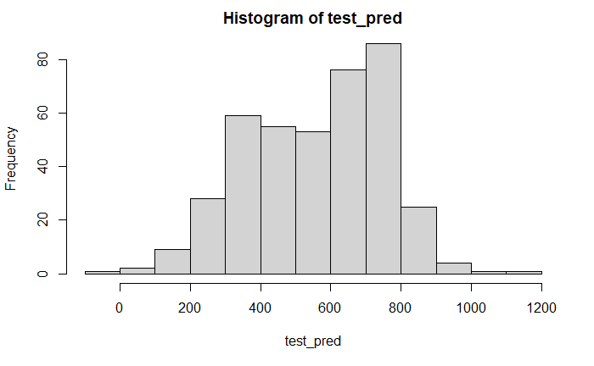
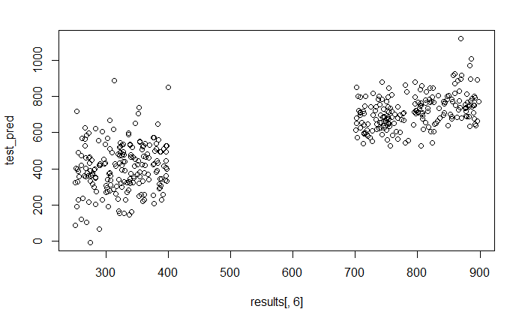

Slide 16
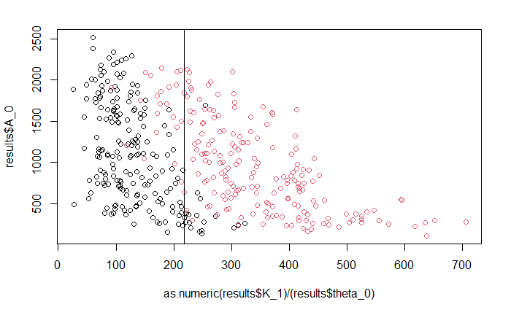
Single cell data, varying n
Line method CV accuracy: 0.9425
Logistic CV accuracy:
K1,A1: 0.9325
K1 scale: .8925
Ridge K1,A1
RMSE: 128.4914
MAD: 104.0346
Linear K1 scaled, A1 scaled, p0
RMSE: 149.158
MAD: 121.3888
R^2: .6259
Linear K1,A1
RMSE: 127.6189
MAD: 102.8037
R^2: .7153

Slide 17
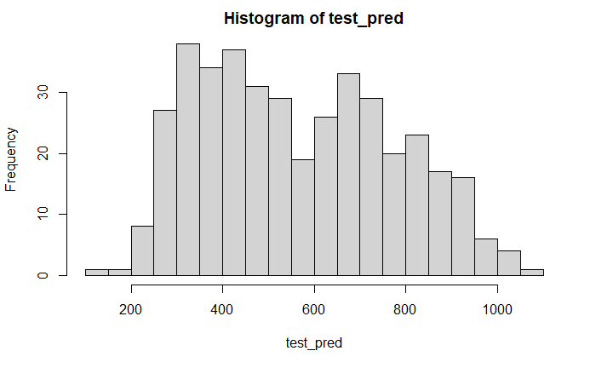
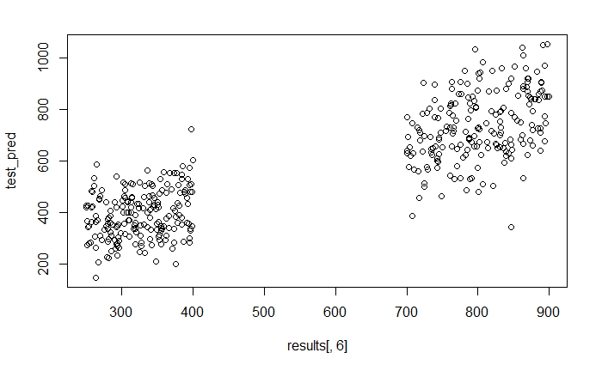

Slide 18
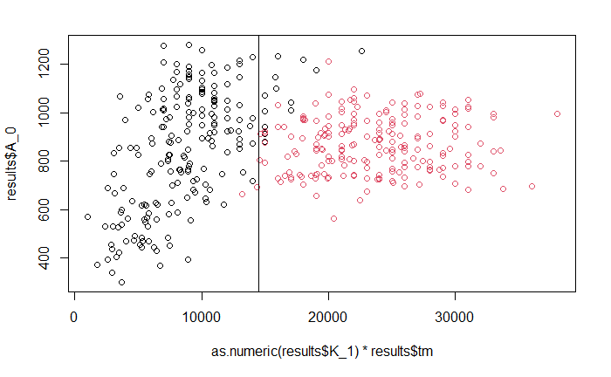
Single cell data, varying tm+1
Line method CV accuracy: 0.955
Logistic CV accuracy:
K1 scale: 0.8775
K1, A1: .9575
Ridge K1,A1
RMSE: 116.7739
MAD: 92.5891
Linear K1,A1
RMSE: 115.5988
MAD: 91.6774
R^2: .7192
Linear K1 scaled, A1 scaled, p0
RMSE: 101.0786
MAD: 73.8478
R^2: .8401

Slide 19
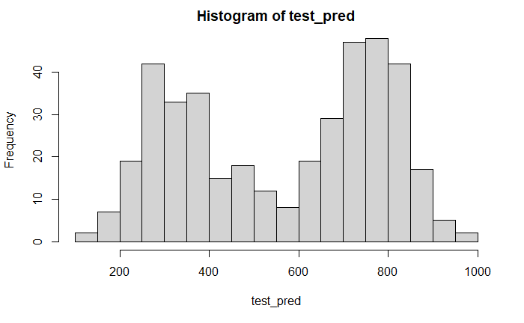
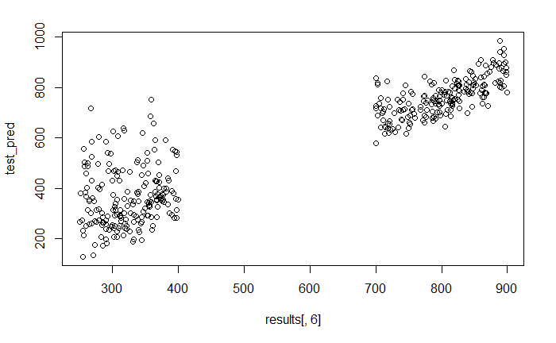

Slide 20
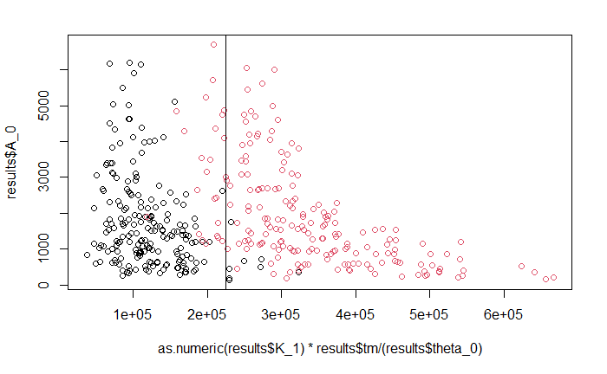
Single cell, varying all three
Line method CV accuracy: .9425
Logistic CV accuracy
K1 scale: .8825
K1, A1: .84
Ridge K1,A1
RMSE: 162.9072
MAD: 137.5664
Linear K1,A1
RMSE: 161.6171
MAD: 135.2986
R^2: .5461
Linear K1 scaled, A1 scaled, p0
RMSE: 156.665
MAD: 127.9208
R^2: .6028

Slide 21
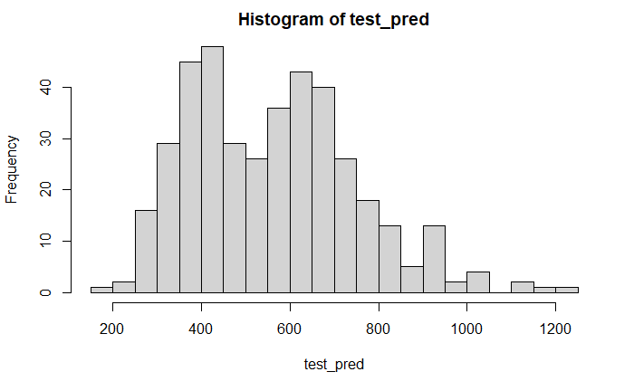
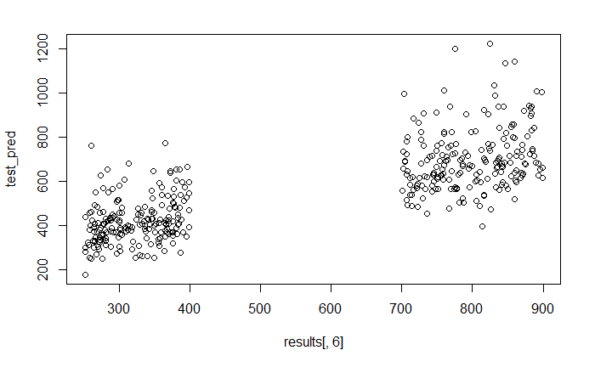

Slide 22
Conclusions
Line method fairly robust, almost all >0.9
Depends on scaling
Logistic - suffered a bit, but still >0.85
Including more variables generally (not always) resulted in better fit
Too many = overfitting
Ridge performance not necessarily better than linear
Harder to measure performance - p-vals, R^2
Linear error increased substantially, but still significant results
R^2 ~0.9 -> ~0.6 range
RMSE/MAD 30-50 -> 120-150 range
Clusters less prominent

